Slide 1

Online library management system
Submitted By
Kamaljeet singh rana
170610330054
Submitted To
Faculty of Computer Science & Applications
Amrapali Institute of Applied Sciences, Haldwani

Slide 2

Acknowledgement
Guide
Dr. Pramod Joshi

Slide 3
Introduction
The online library system is one of the most effective ways of organizing a library and using technological options to make management of resources more efficient. The library software can be used by both big and small colleges and schools for a better management of their books and more importantly for decreasing manual labor and time.

Slide 4
Existing System
Manual System
Difficult To Maintain
Time manipulation
Updating task is tedious

Slide 5
Objective of the system
More accuracy
Speed improvement
Integrity
Better error handling

Slide 6
Core Components
hardware
Processor: Intel Core I 3
software
Operating system: Windows 10
RAM: 2 GB
Hard Disc: 20 GB
Technology: PHP, HTML, JAVASCRIPT
Development Tools: XAMPP Server
Back End :My SQL

Slide 7
System flow

Slide 8
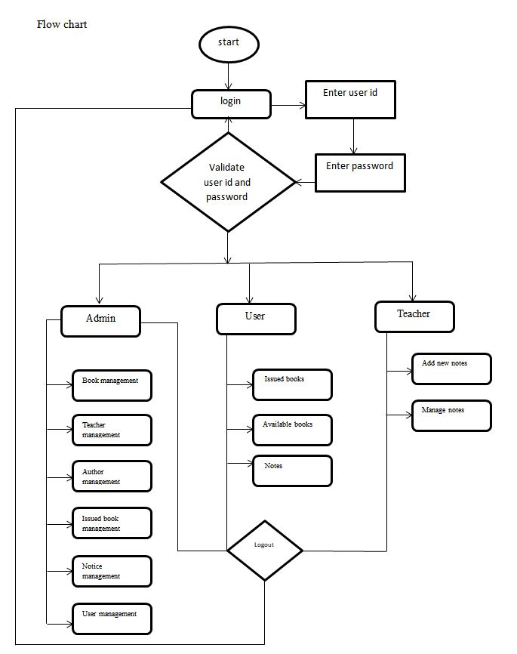

Slide 9
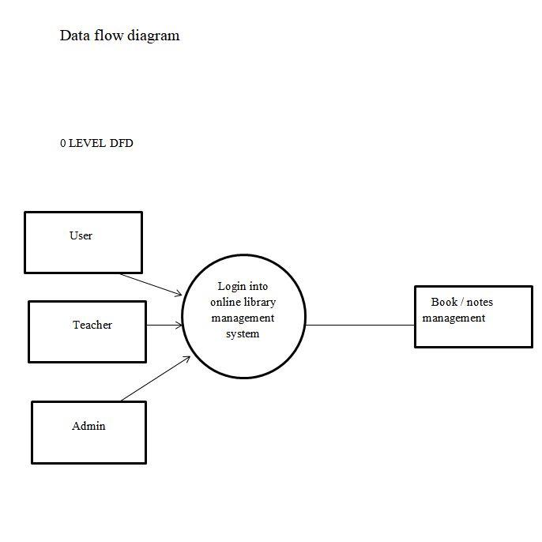

Slide 10
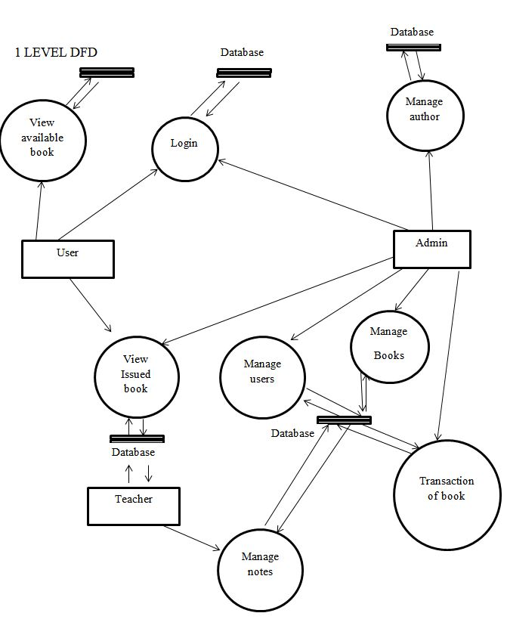

Slide 11
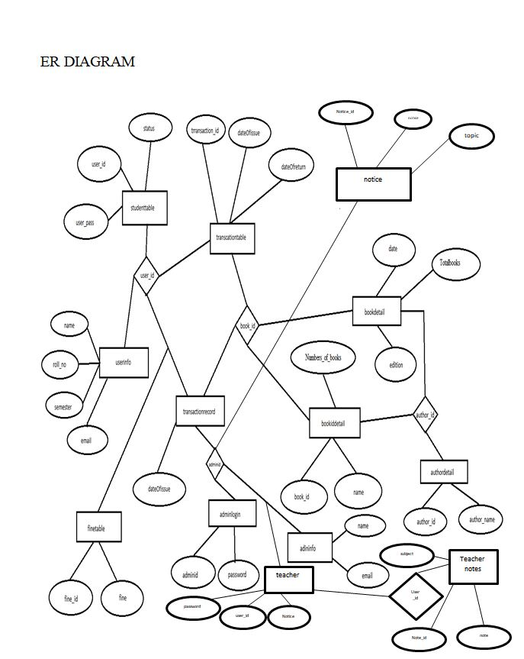

Slide 12
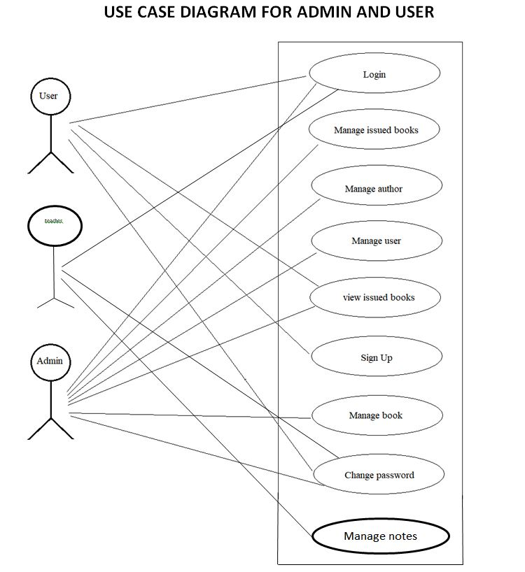

Slide 13
Input output screen

Slide 14
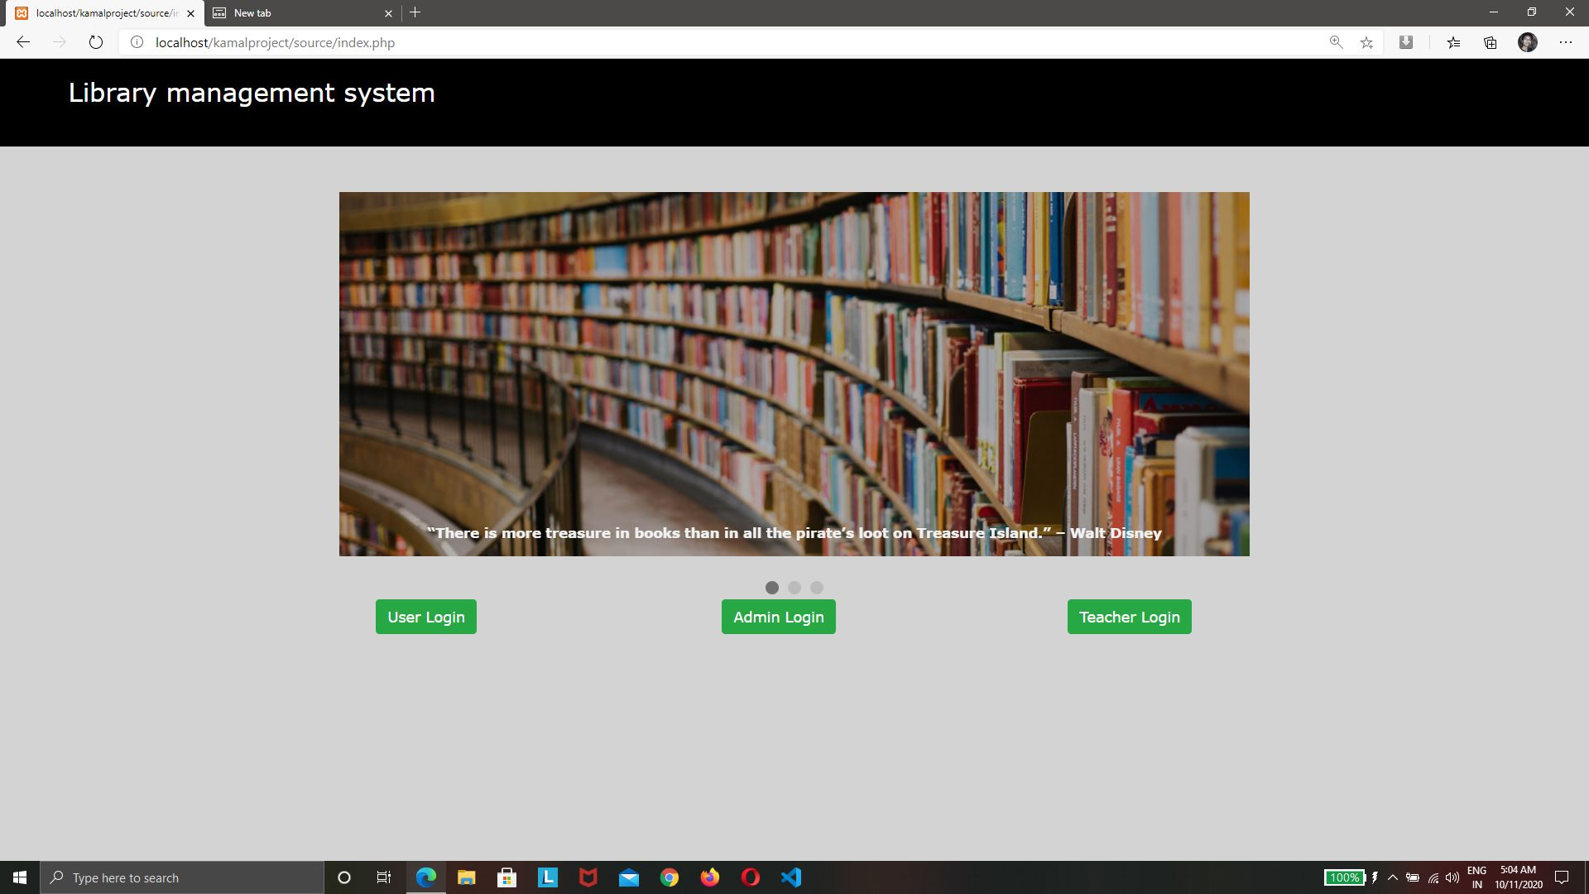

Slide 15
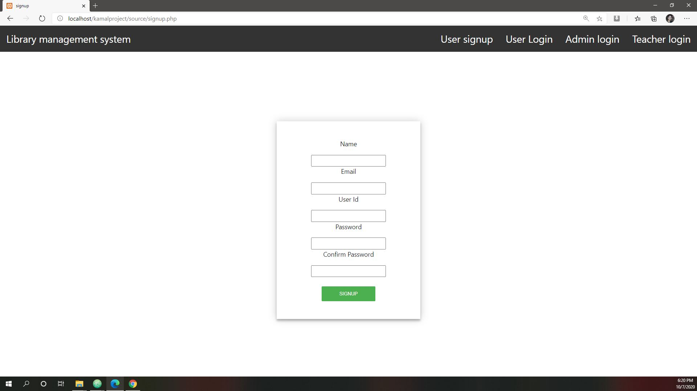
Sign up

Slide 16
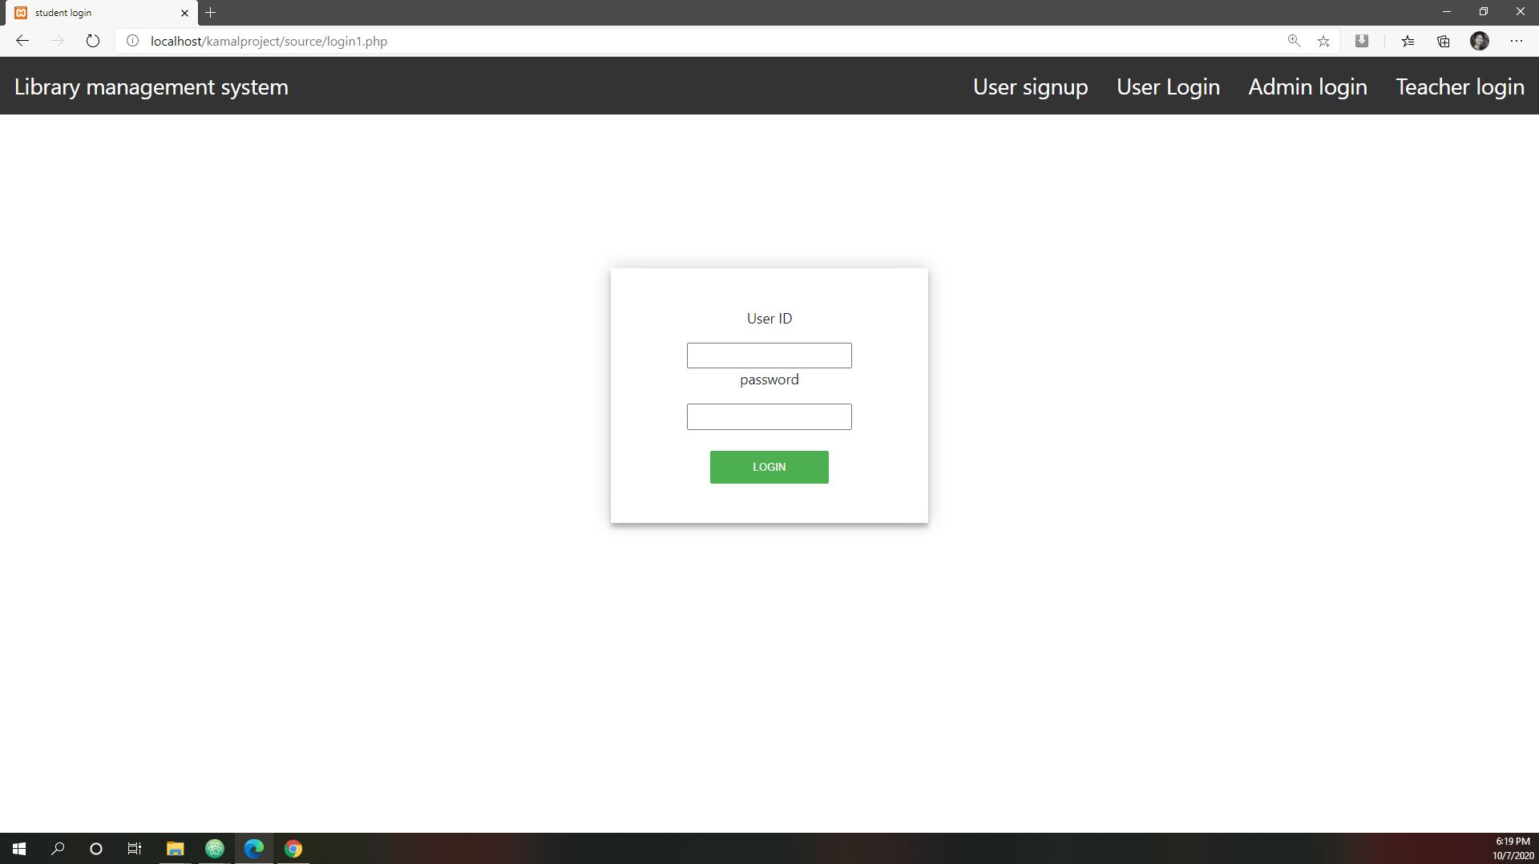
User login

Slide 17
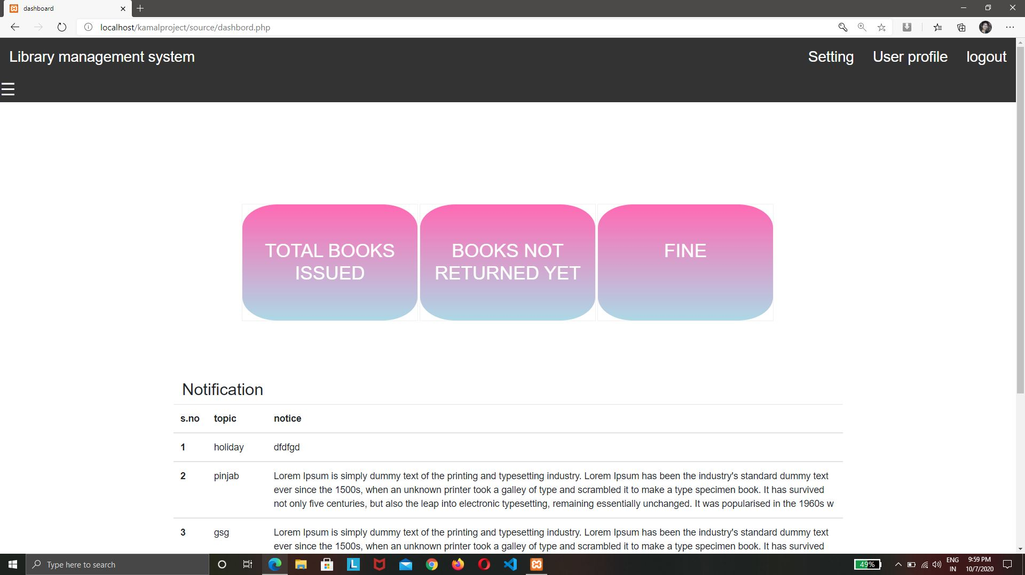
User Dashboard

Slide 18
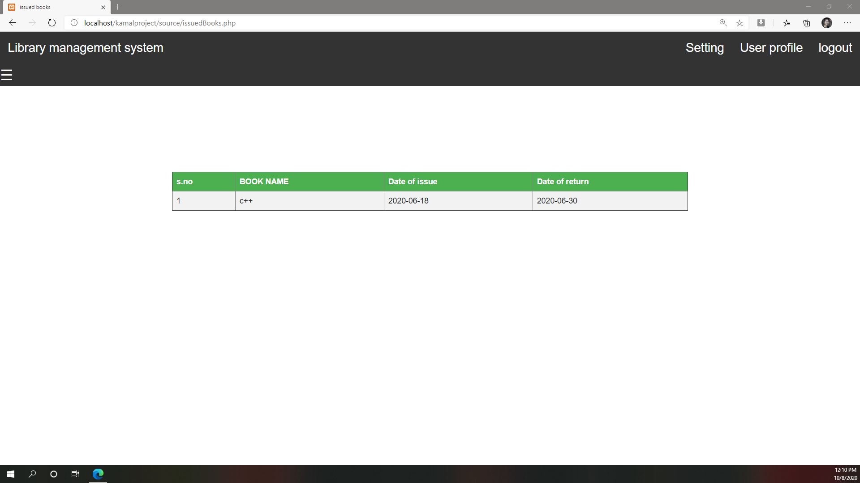

Slide 19
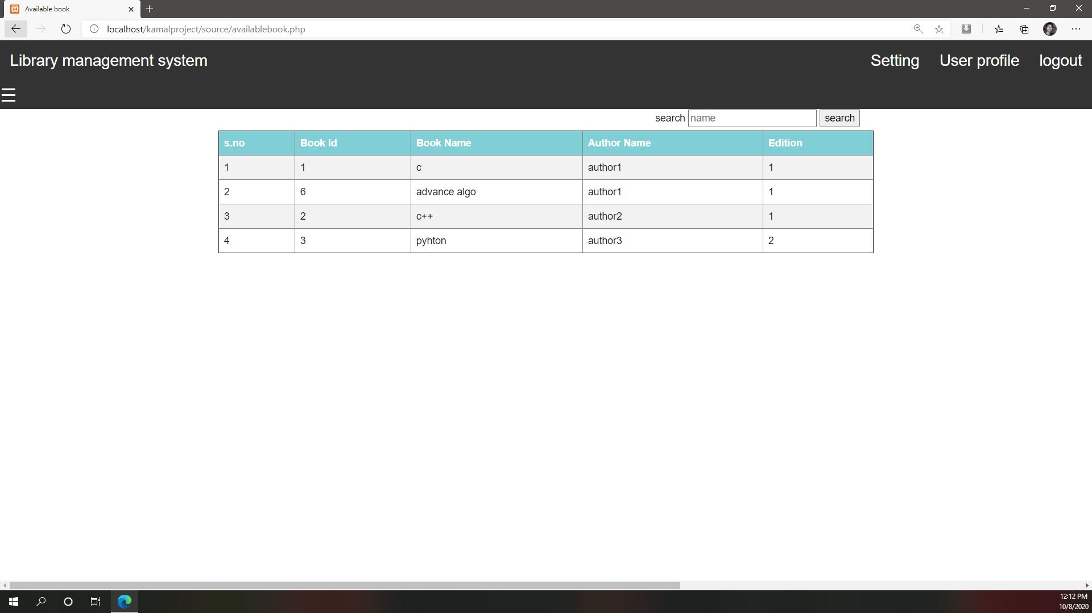

Slide 20
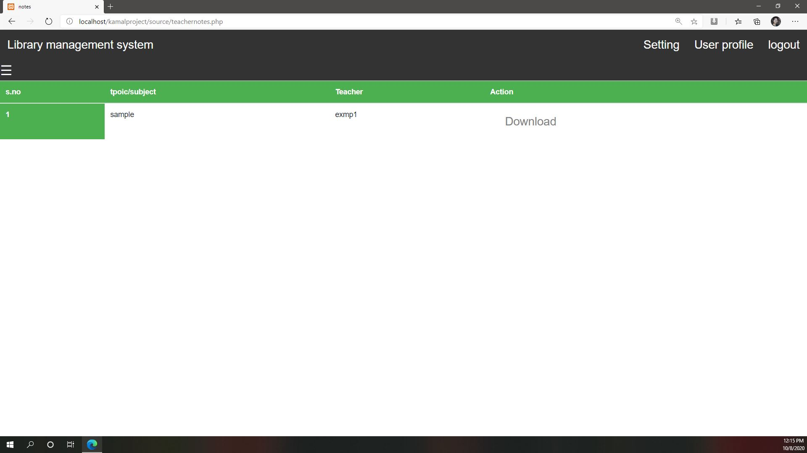

Slide 21
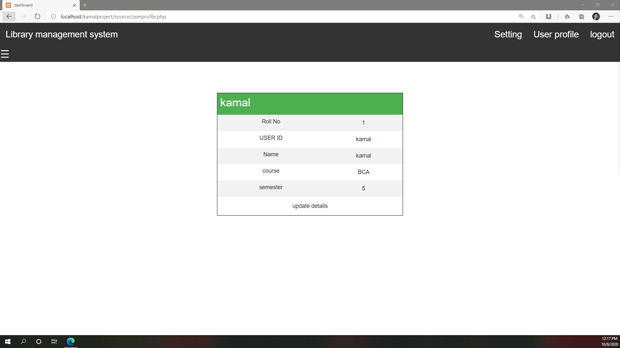

Slide 22
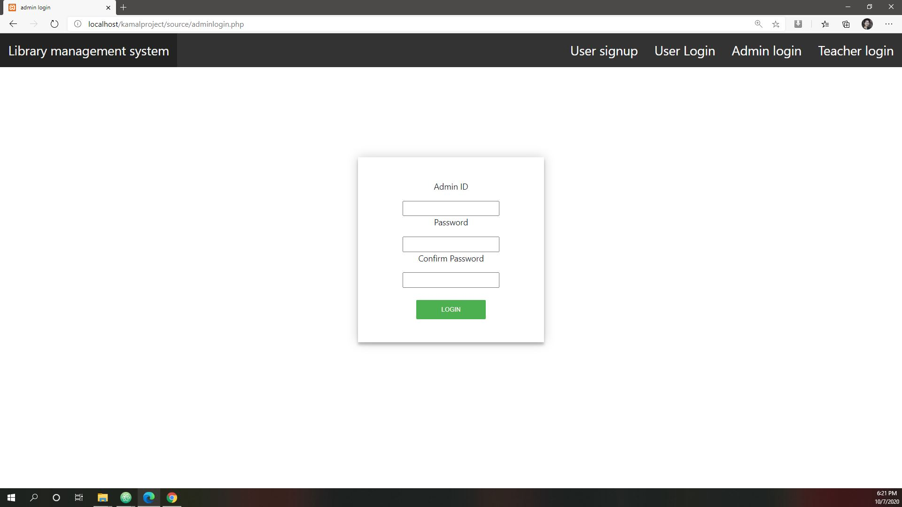
Admin login

Slide 23
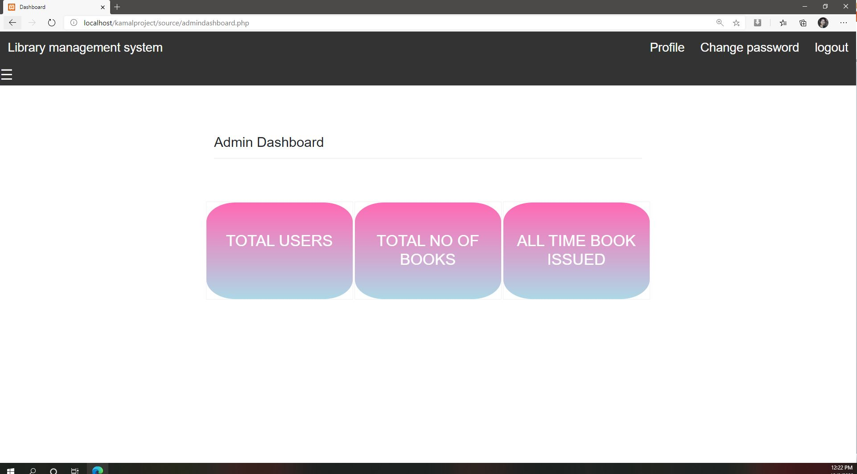

Slide 24
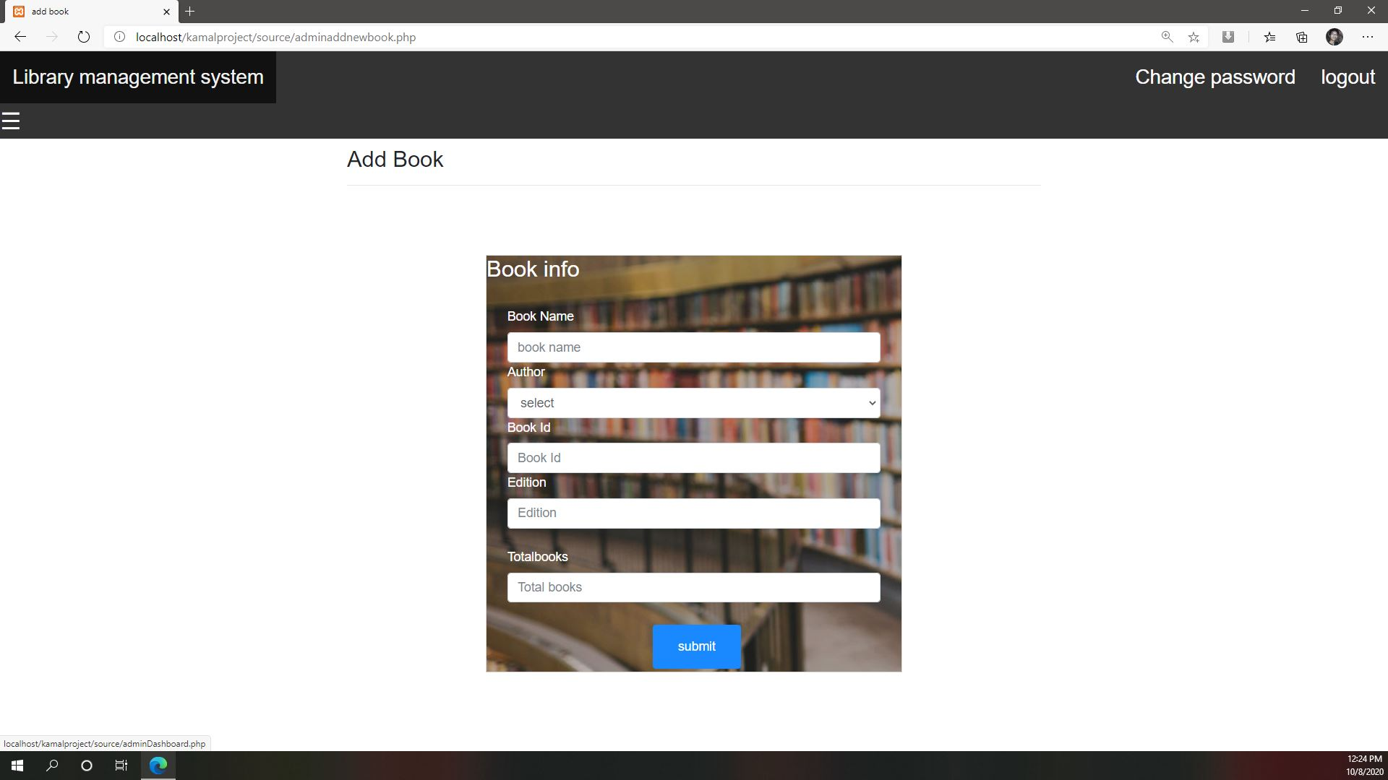

Slide 25
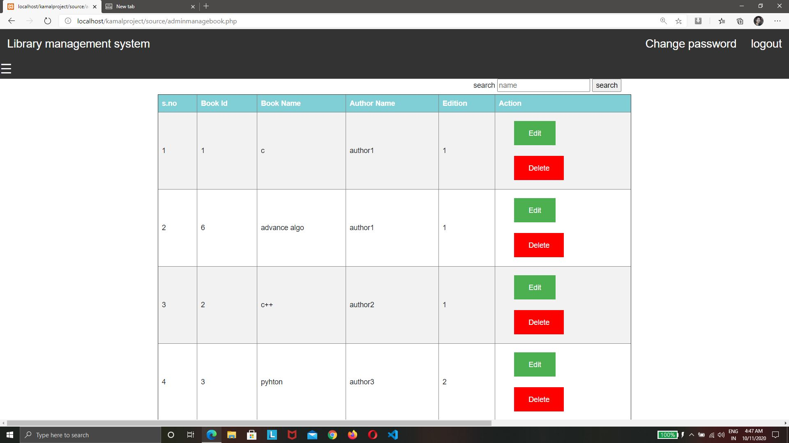

Slide 26
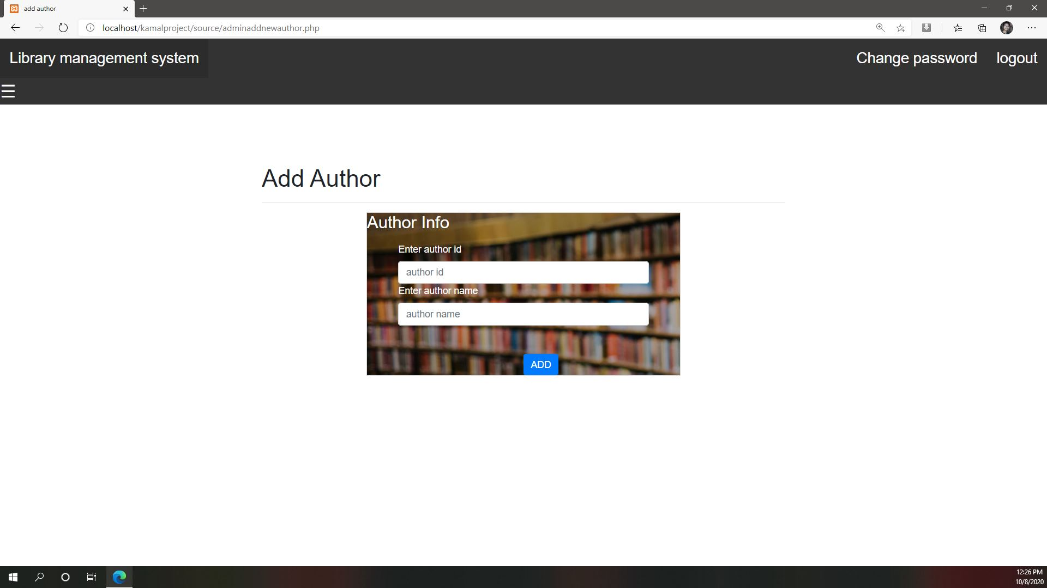

Slide 27
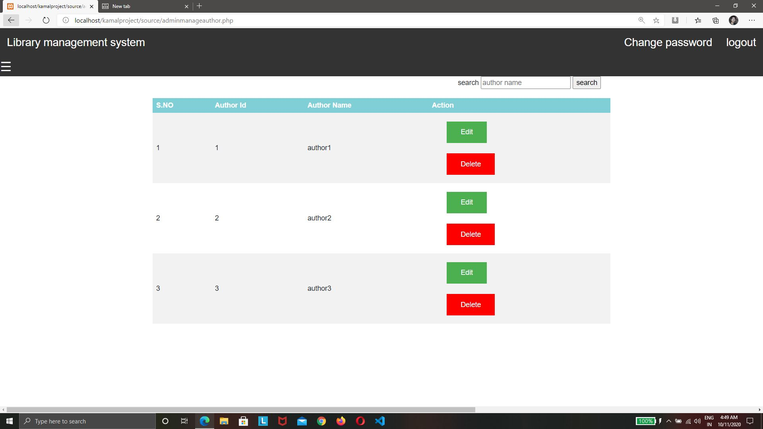

Slide 28
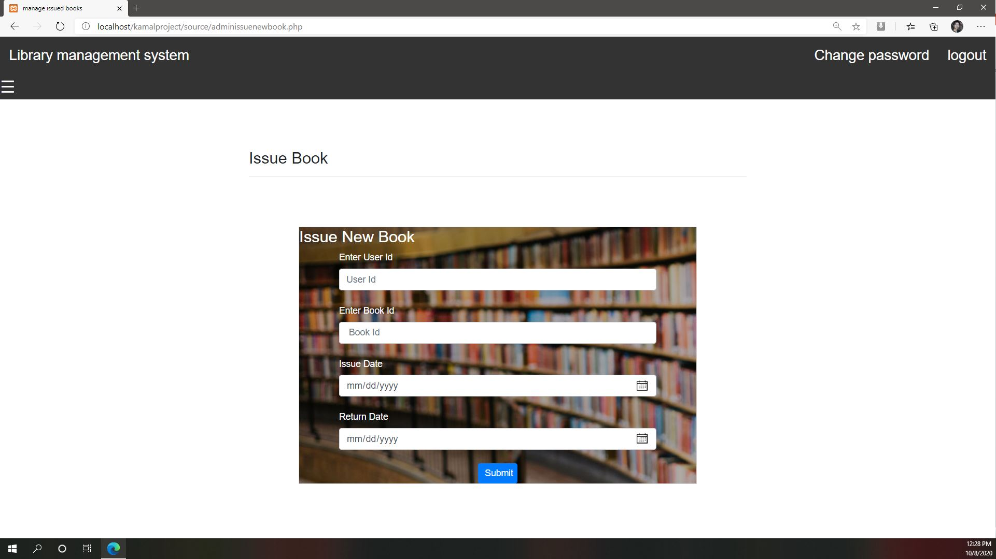

Slide 29
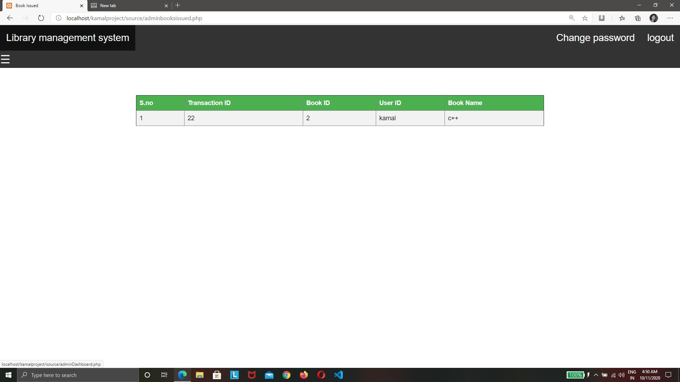

Slide 30
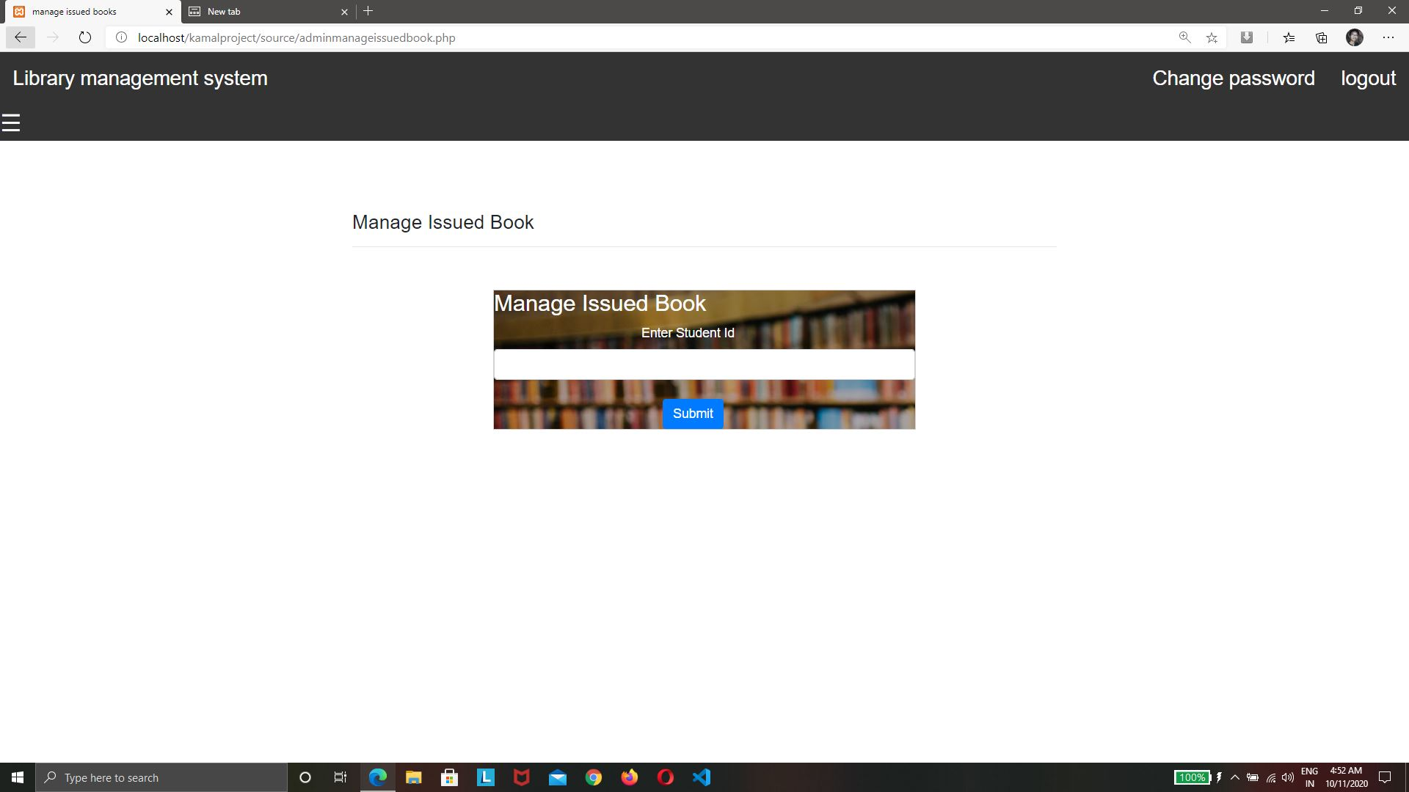

Slide 31
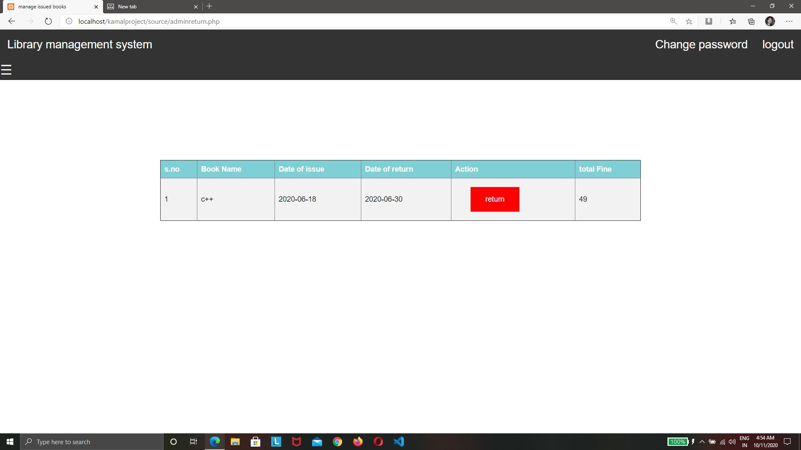

Slide 32
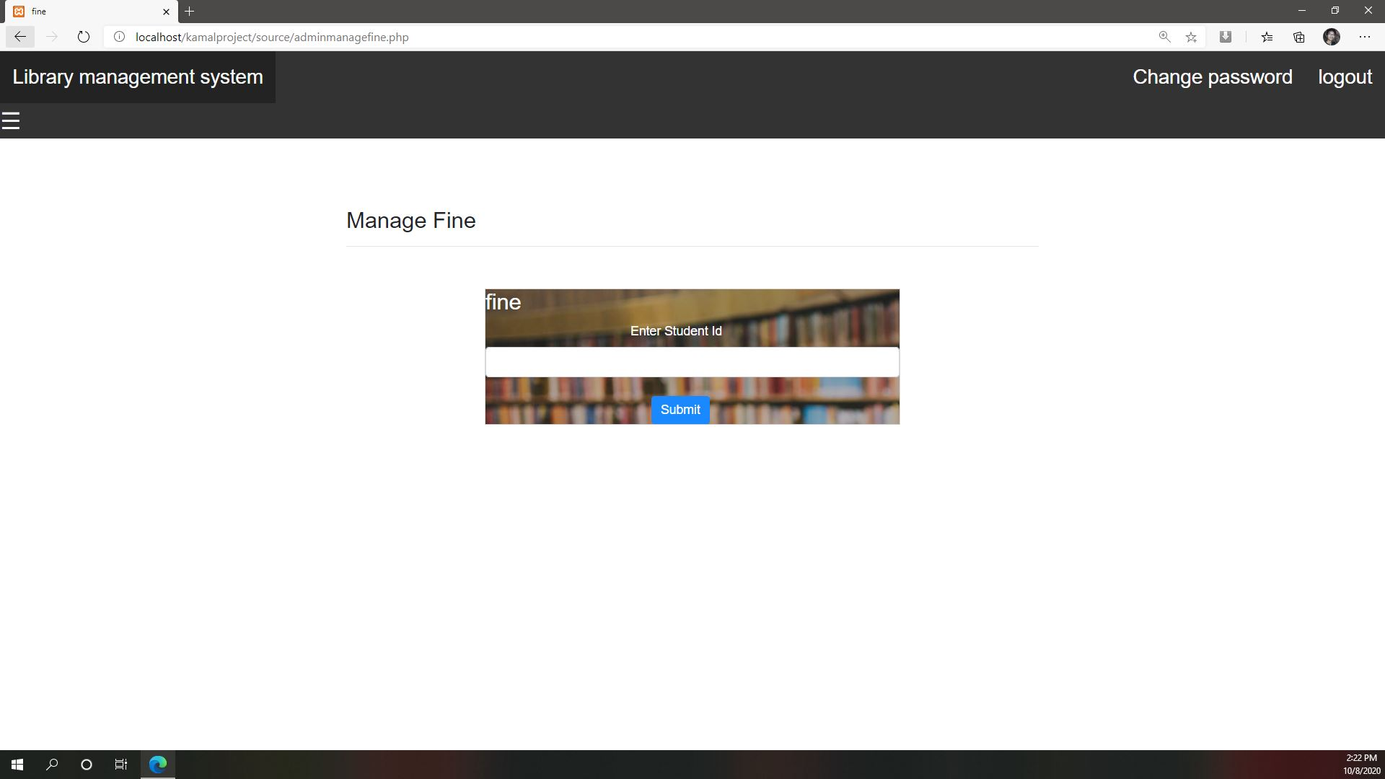

Slide 33
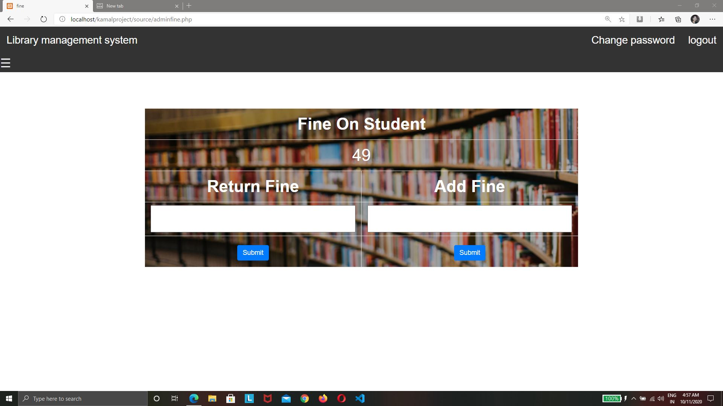

Slide 34
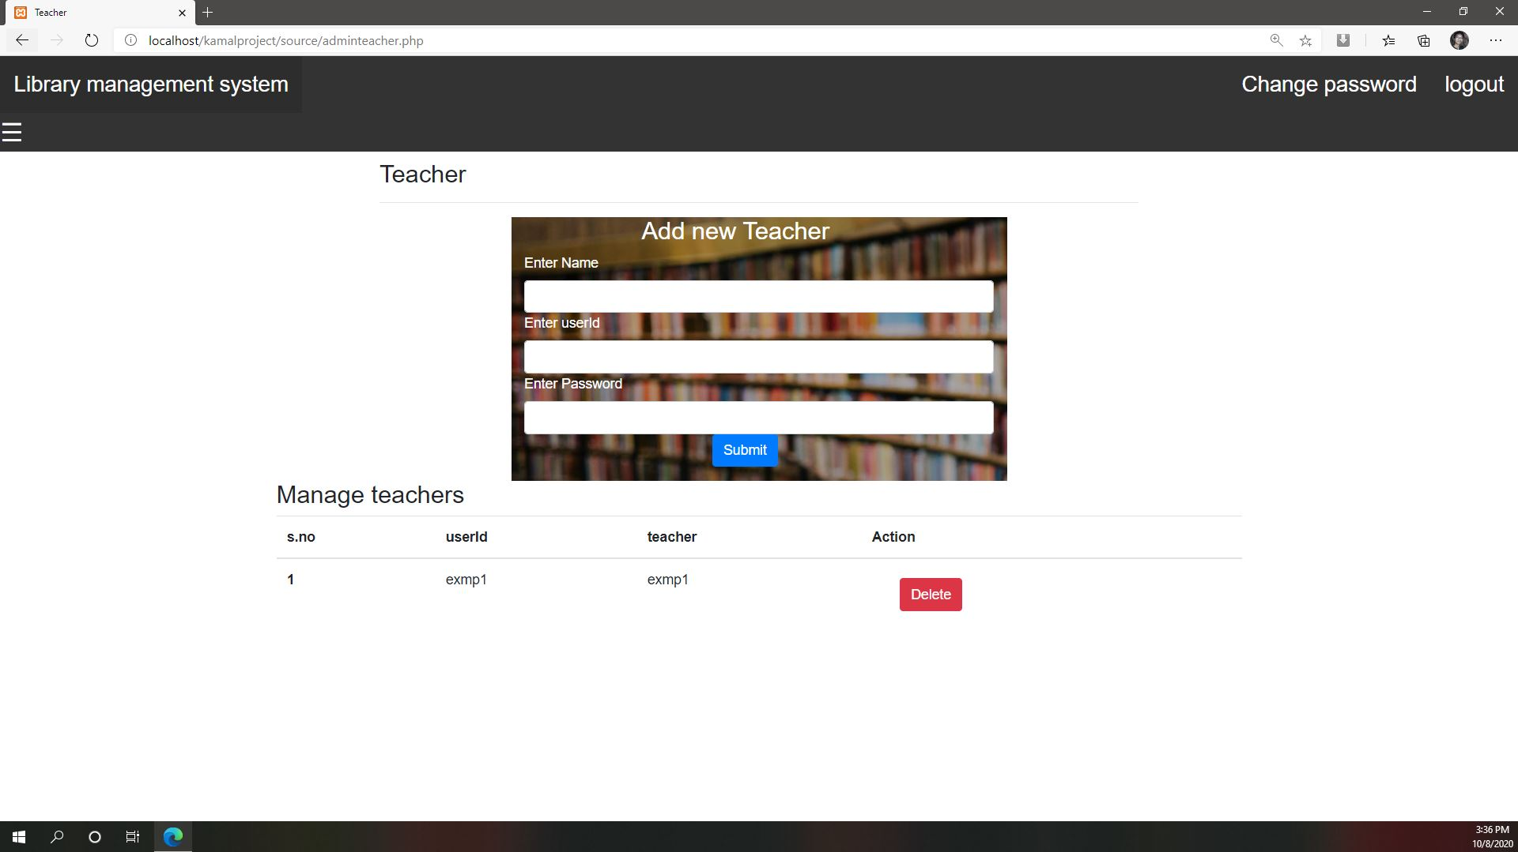

Slide 35
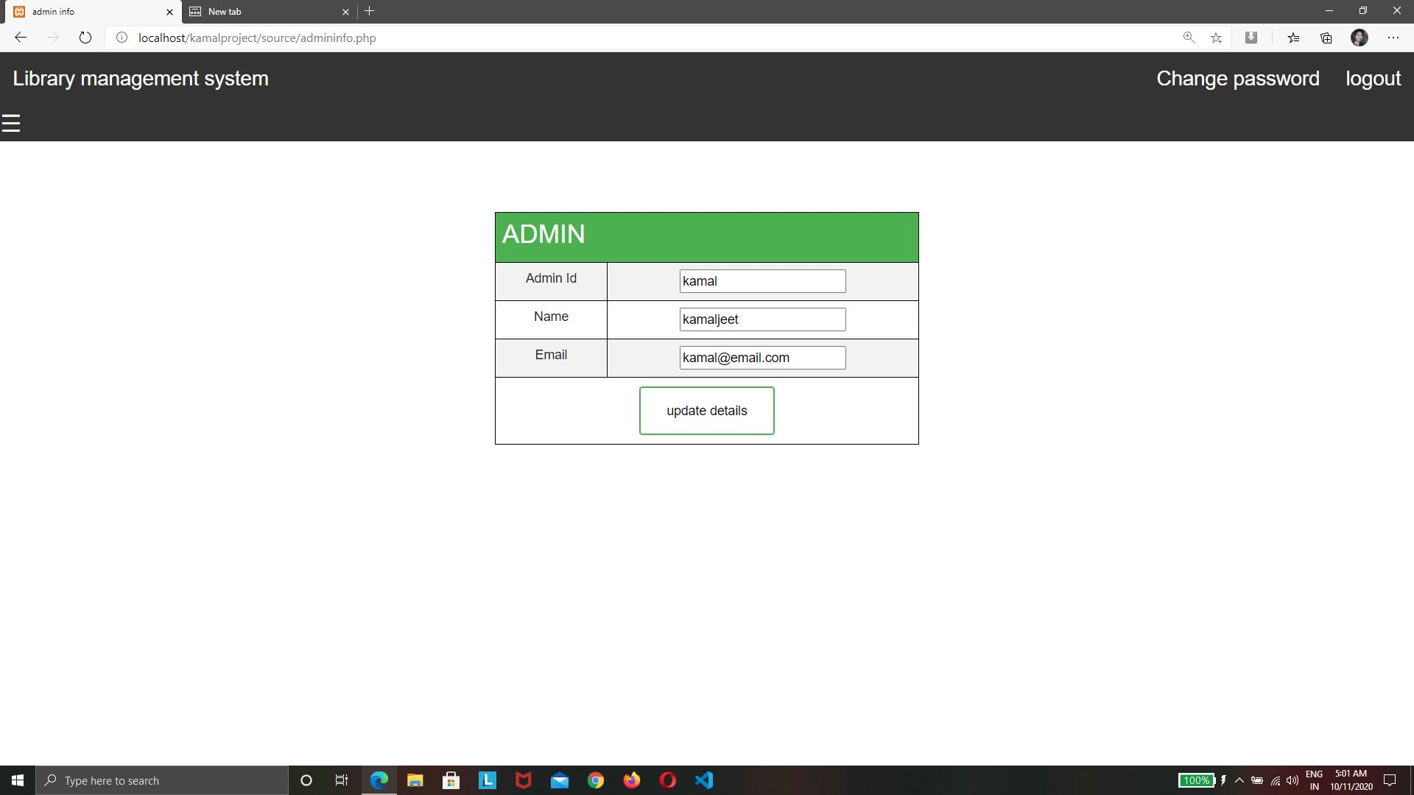
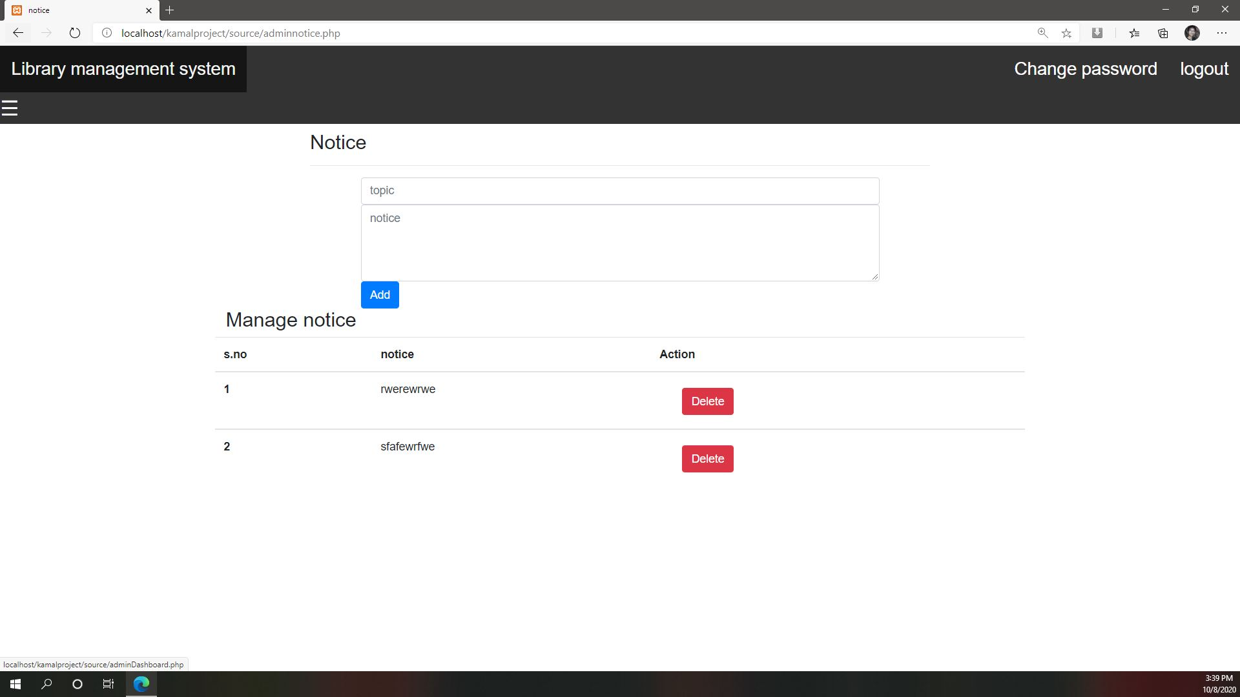

Slide 37
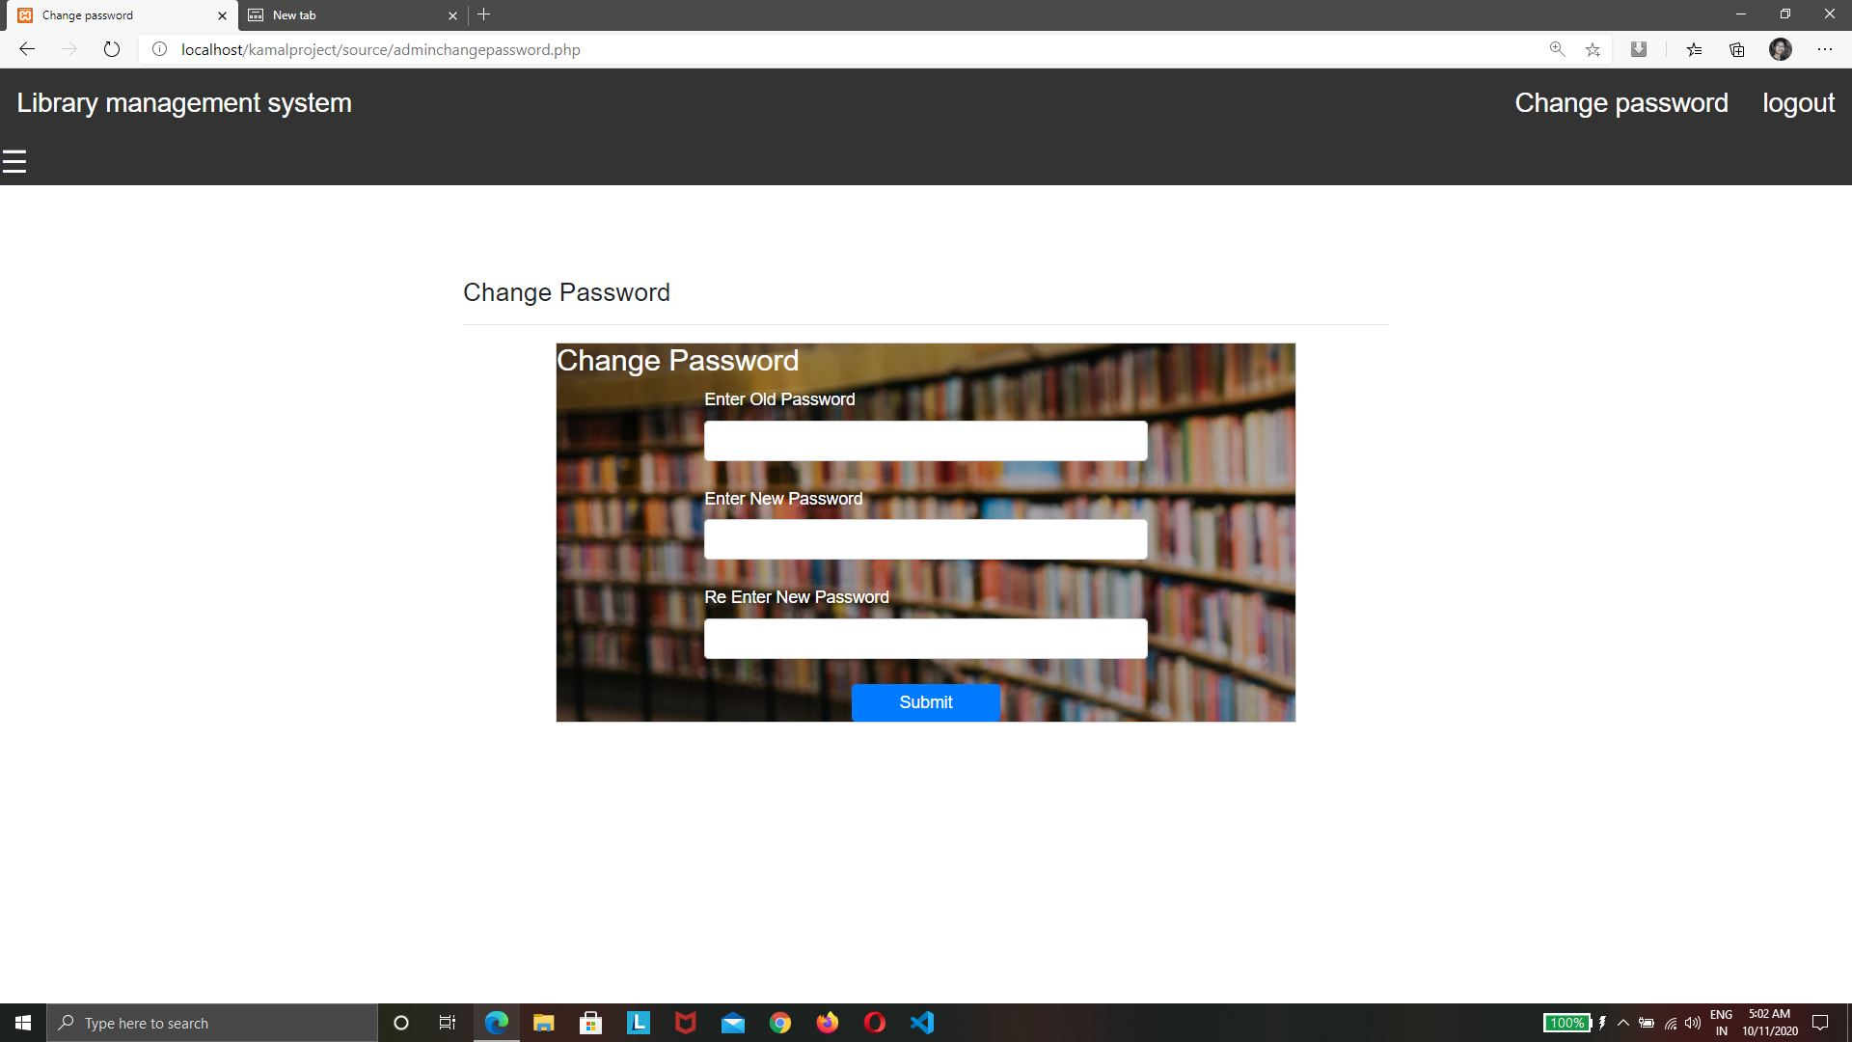

Slide 38

Teacher login

Slide 39
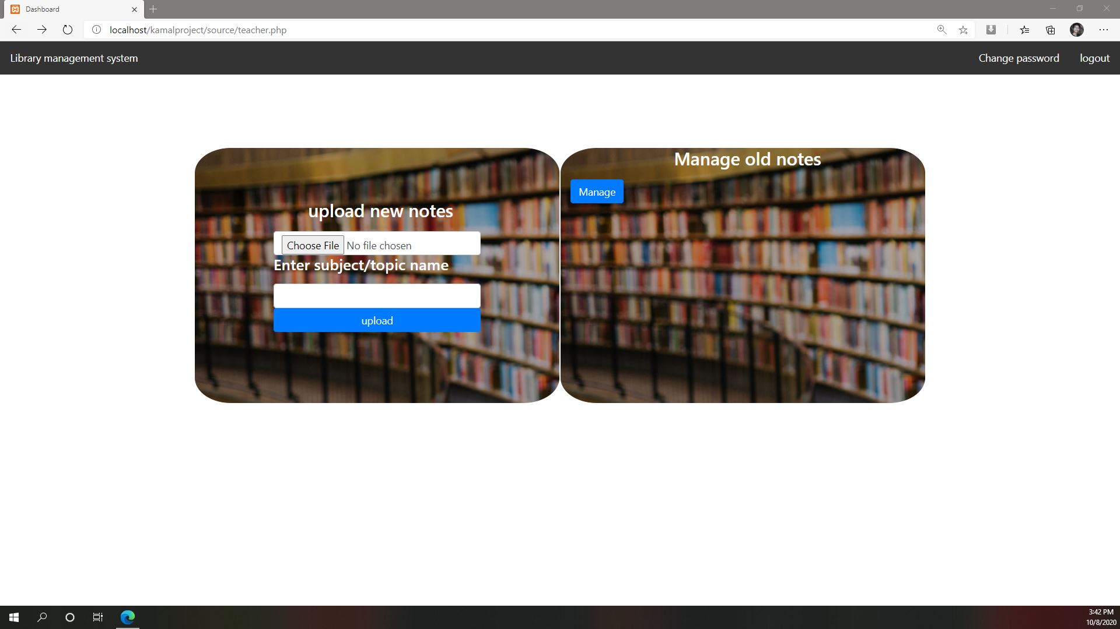

Slide 40
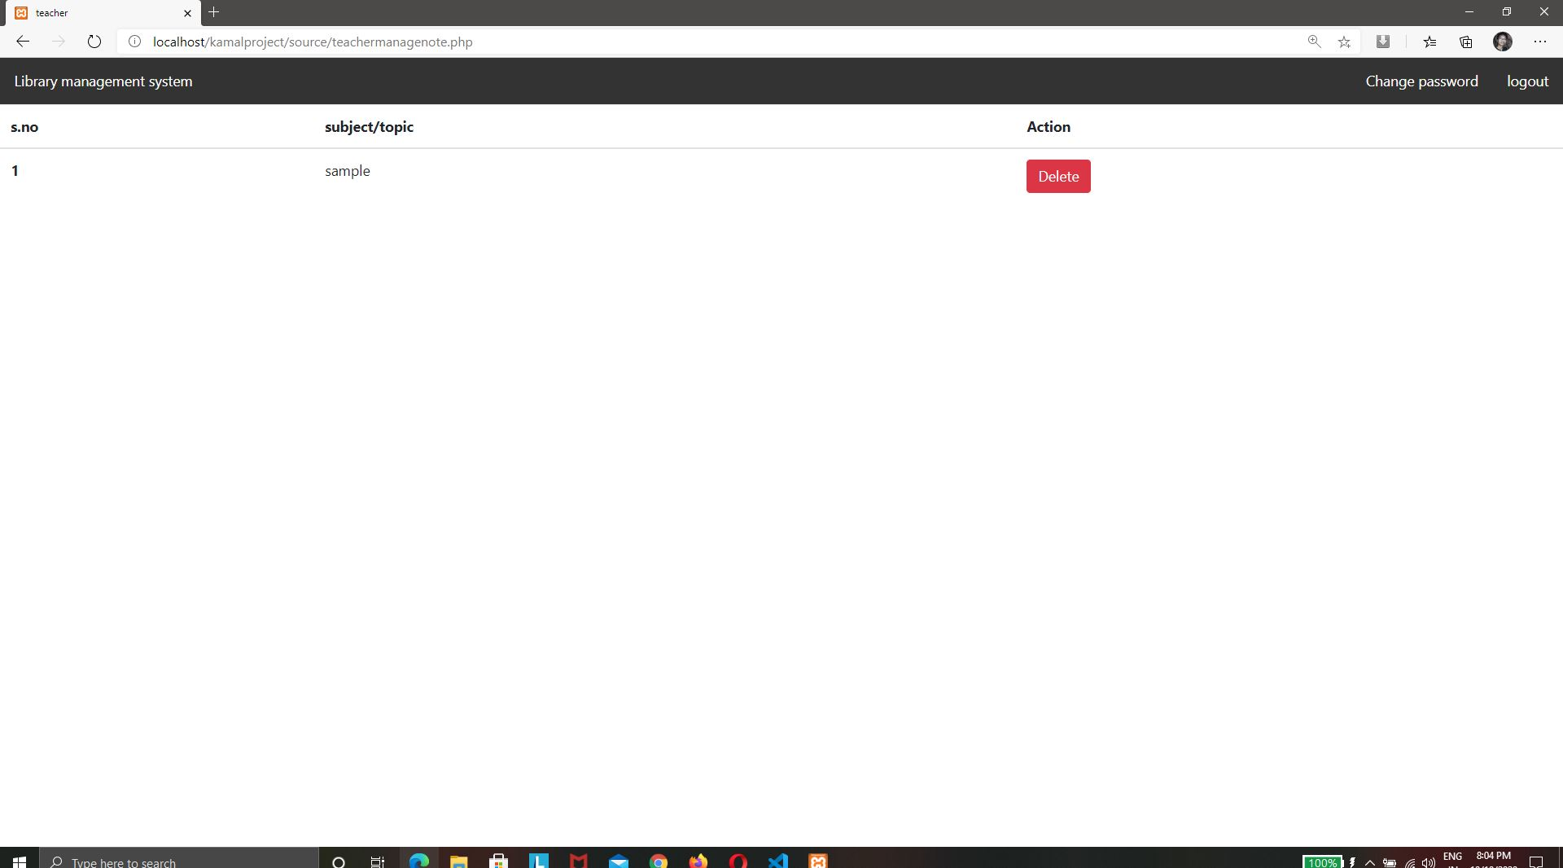

Slide 41
Thank you

